Slide 1
Assortivity HIV Tested Positive Status Example

Slide 2
Form Relationships Based On Tested Positive for HIV Status
Goal: See how the impact of forming relationships based on the individuals HIV Test Status affects the spread of the disease. This is different from HIV_INFECTION_STATUS in that the person needs to have been tested versus just being infected.
Expect: Forming relationships with like status should reduce the spread of the disease.
Re-occurring HIVRapidHIVDiagnostic so that we can test people on are infected or not.
25% of population infected at outbreak.
Initial Population = 175,000
Overridden from Defaults
"Report_Relationship_Start" : 1,
"PFA_Cum_Prob_Selection_Threshold": 0.2,
"PFA_Update_Period_Transitory" : 30,
"PFA_Update_Period_Informal" : 30,
"PFA_Update_Period_Marital" : 30

Slide 3
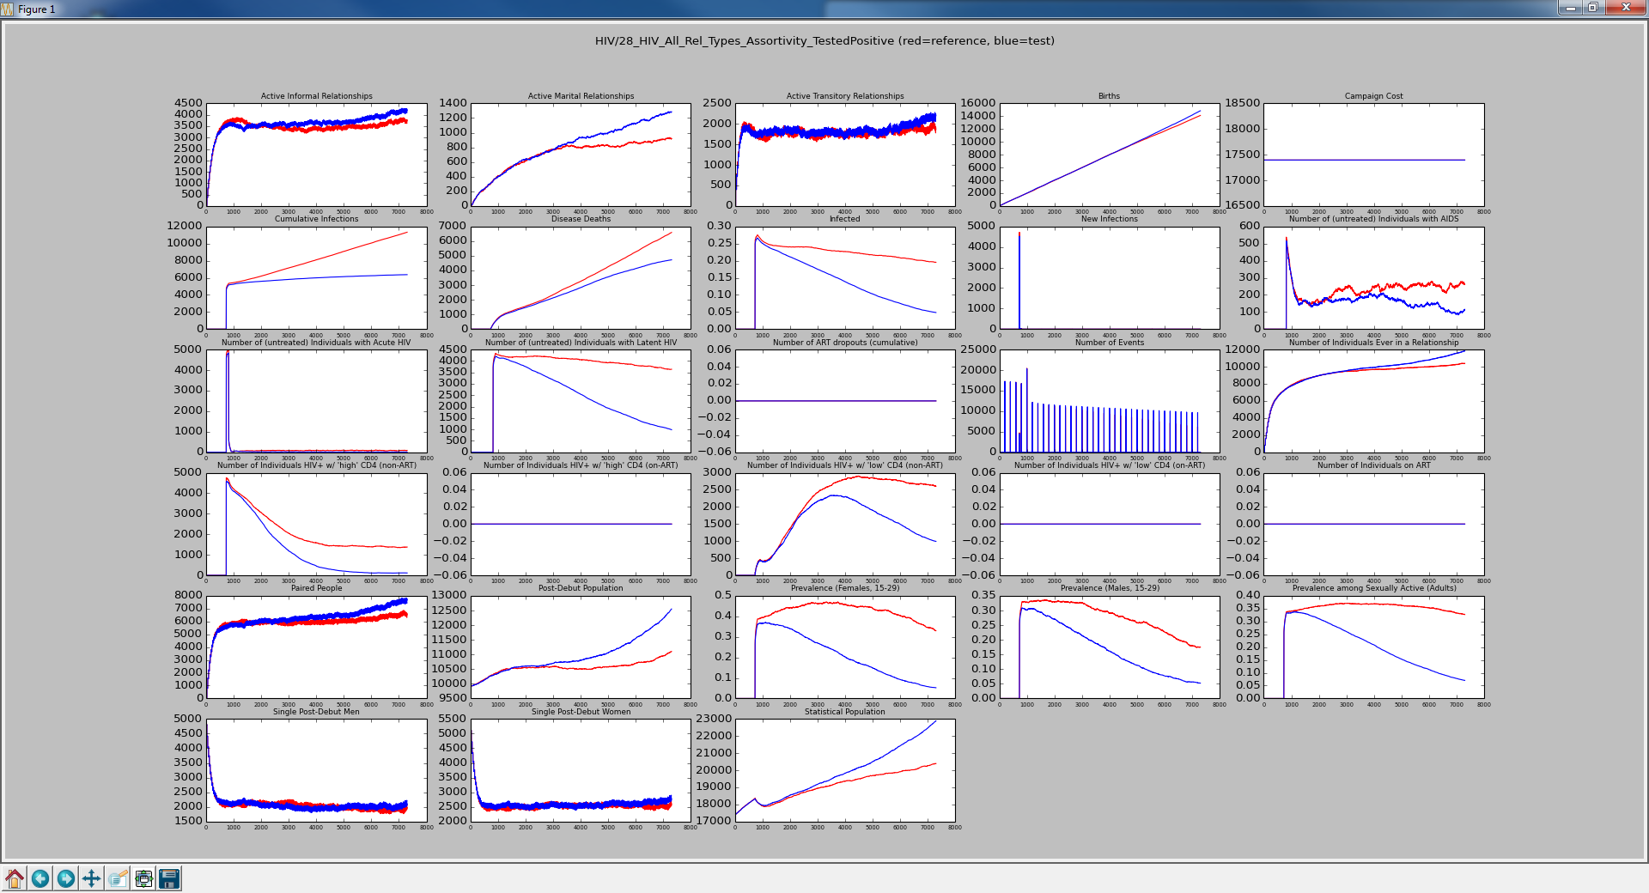
Red is All Types with No Groups Blue is All Types with Matrix
Notice the constant rate of events. These are HIV Testing events that occur every 200 days. No mixed relationships means less spread of infection.
[1.0, 0.0],
[0.0, 1.0]

Slide 4
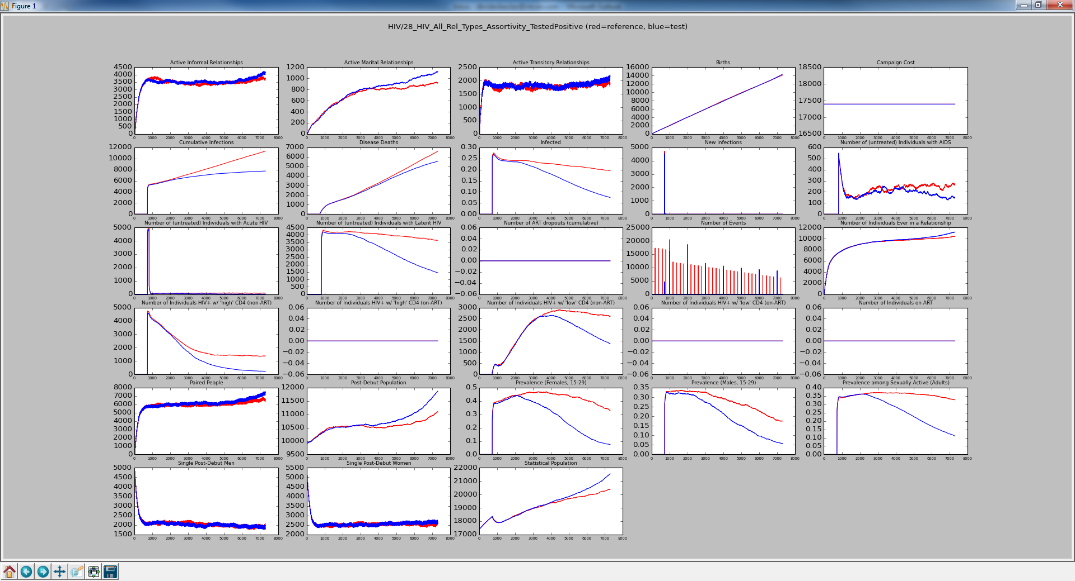
Red is All Types with No Groups Blue is All Types with Matrix
Change the HIV Test to every 1000 days and see increase in infection and deaths.
[1.0, 0.0],
[0.0, 1.0]

Slide 5
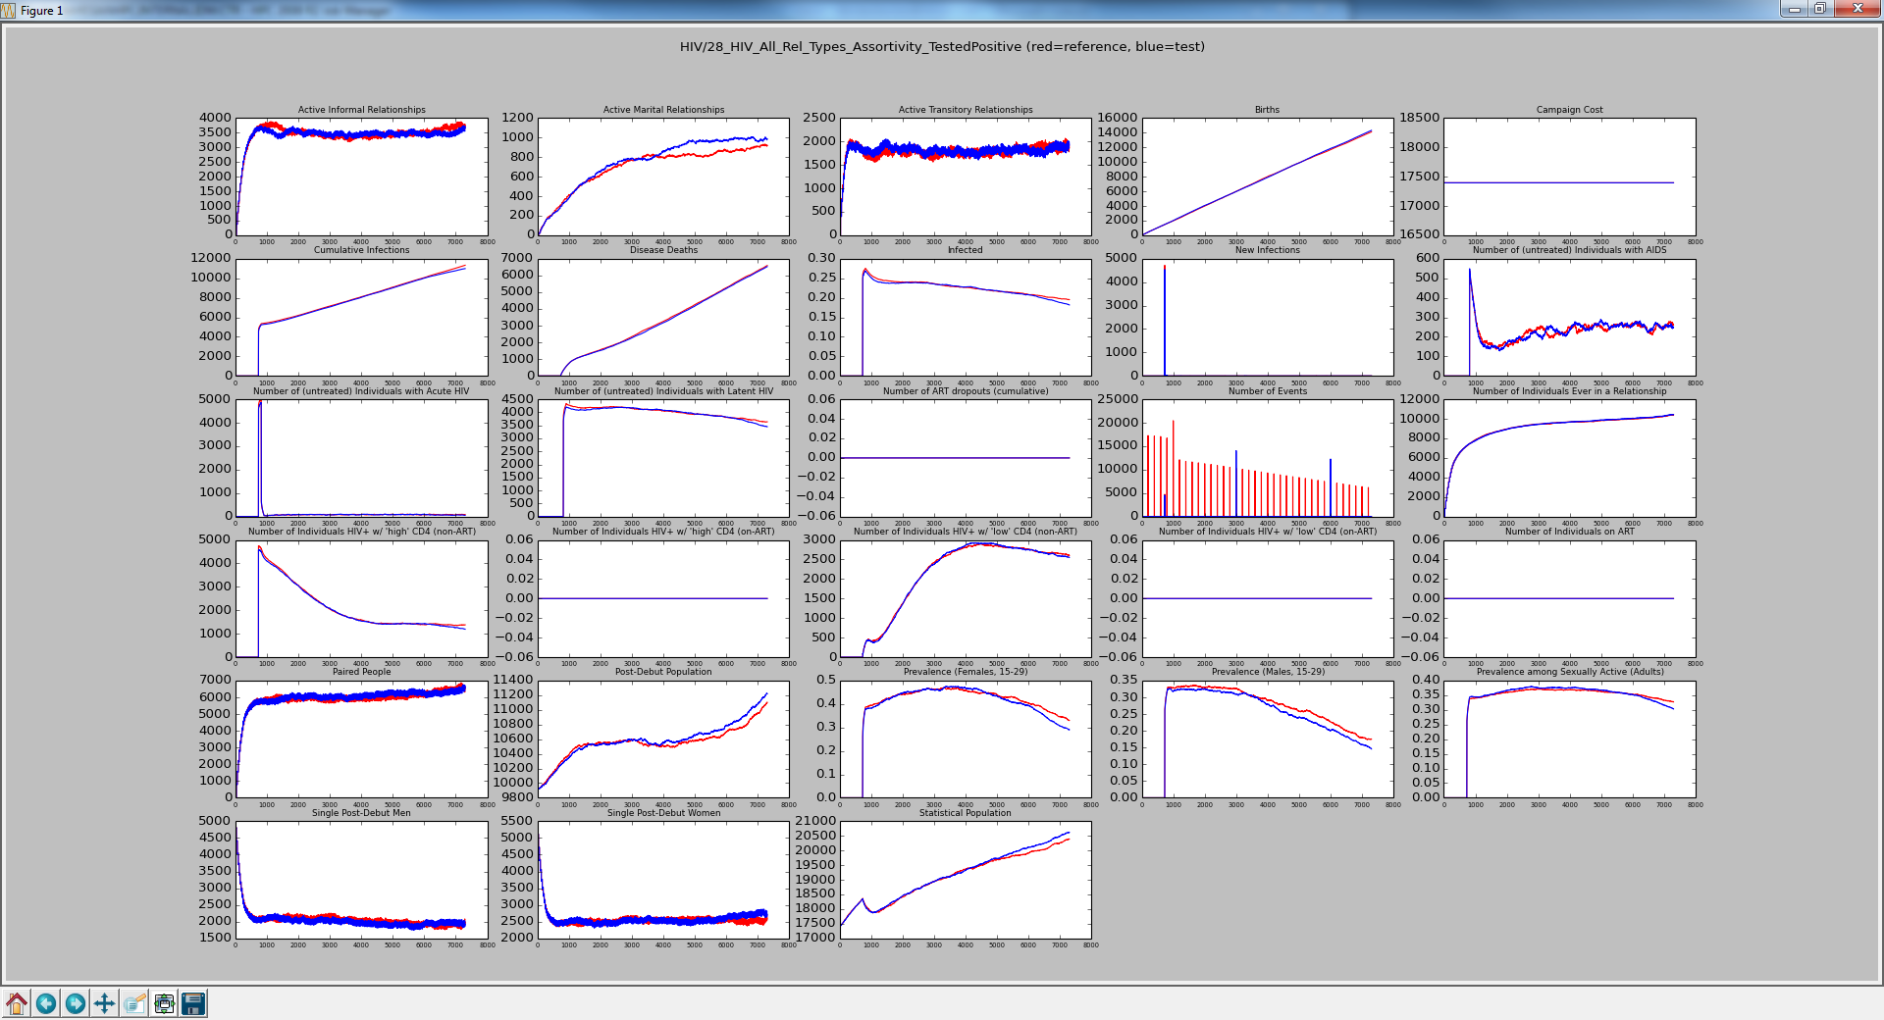
Red is All Types with No Groups Blue is All Types with Matrix
Change the HIV Test to every 3000 days and there is almost no benefit. People don’t know their status.
[1.0, 0.0],
[0.0, 1.0]

Slide 6
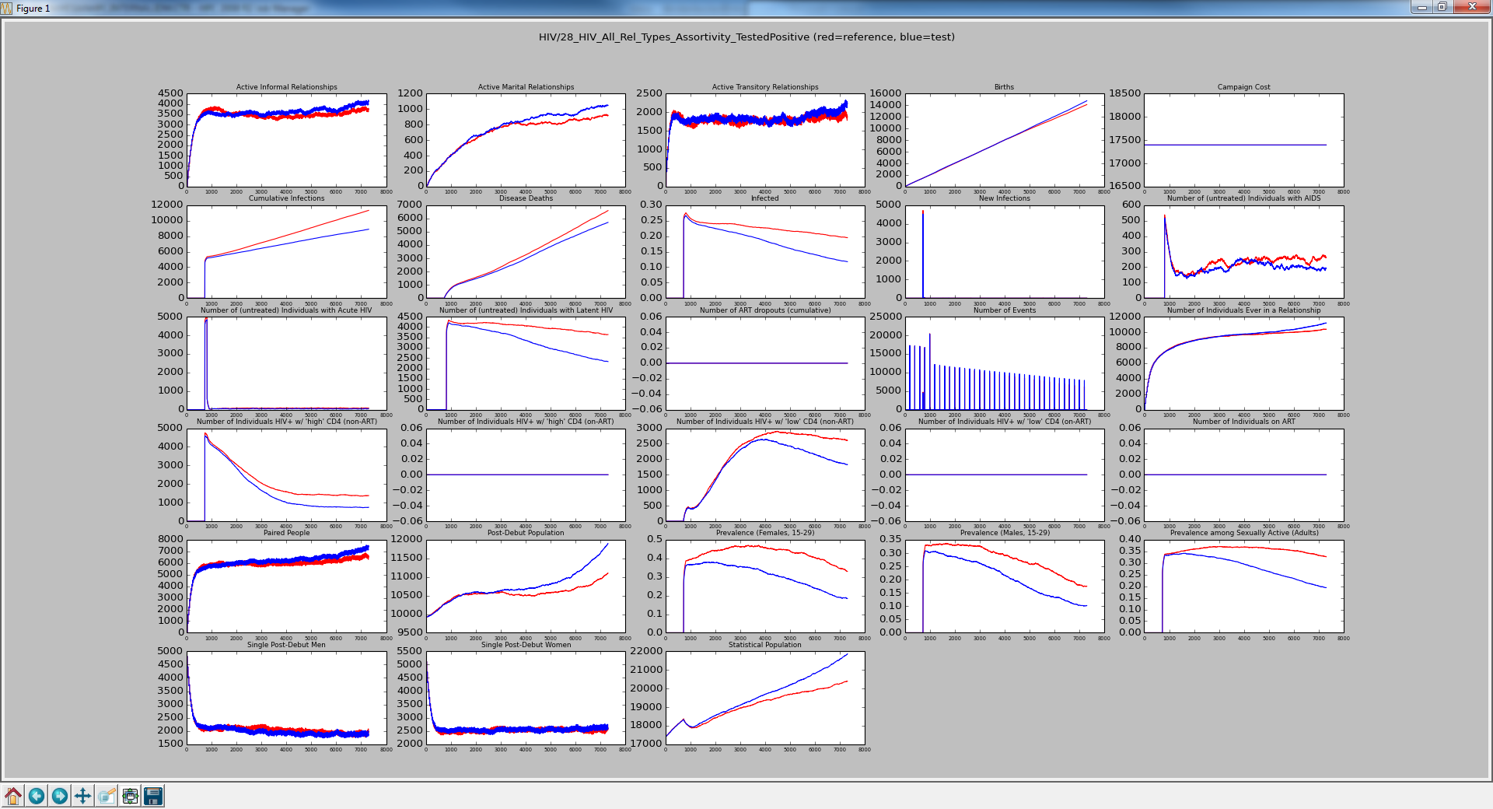
Red is All Types with No Groups Blue is All Types with Matrix
Back to HIV Testing every 200 days, but allow for mixed relationships. Slight increase in number of infections compared to [1, 0], [0, 1].
[0.9, 0.1],
[0.1, 0.9]

Slide 7

Red is All Types with No Groups Blue is All Types with Matrix
[0.8, 0.2],
[0.2, 0.8]
More mixed relationships, implies more spread of infection.

Slide 8

Red is All Types with No Groups Blue is All Types with Matrix
[0.7, 0.3],
[0.3, 0.7]
More mixing = more spread of disease

Slide 9
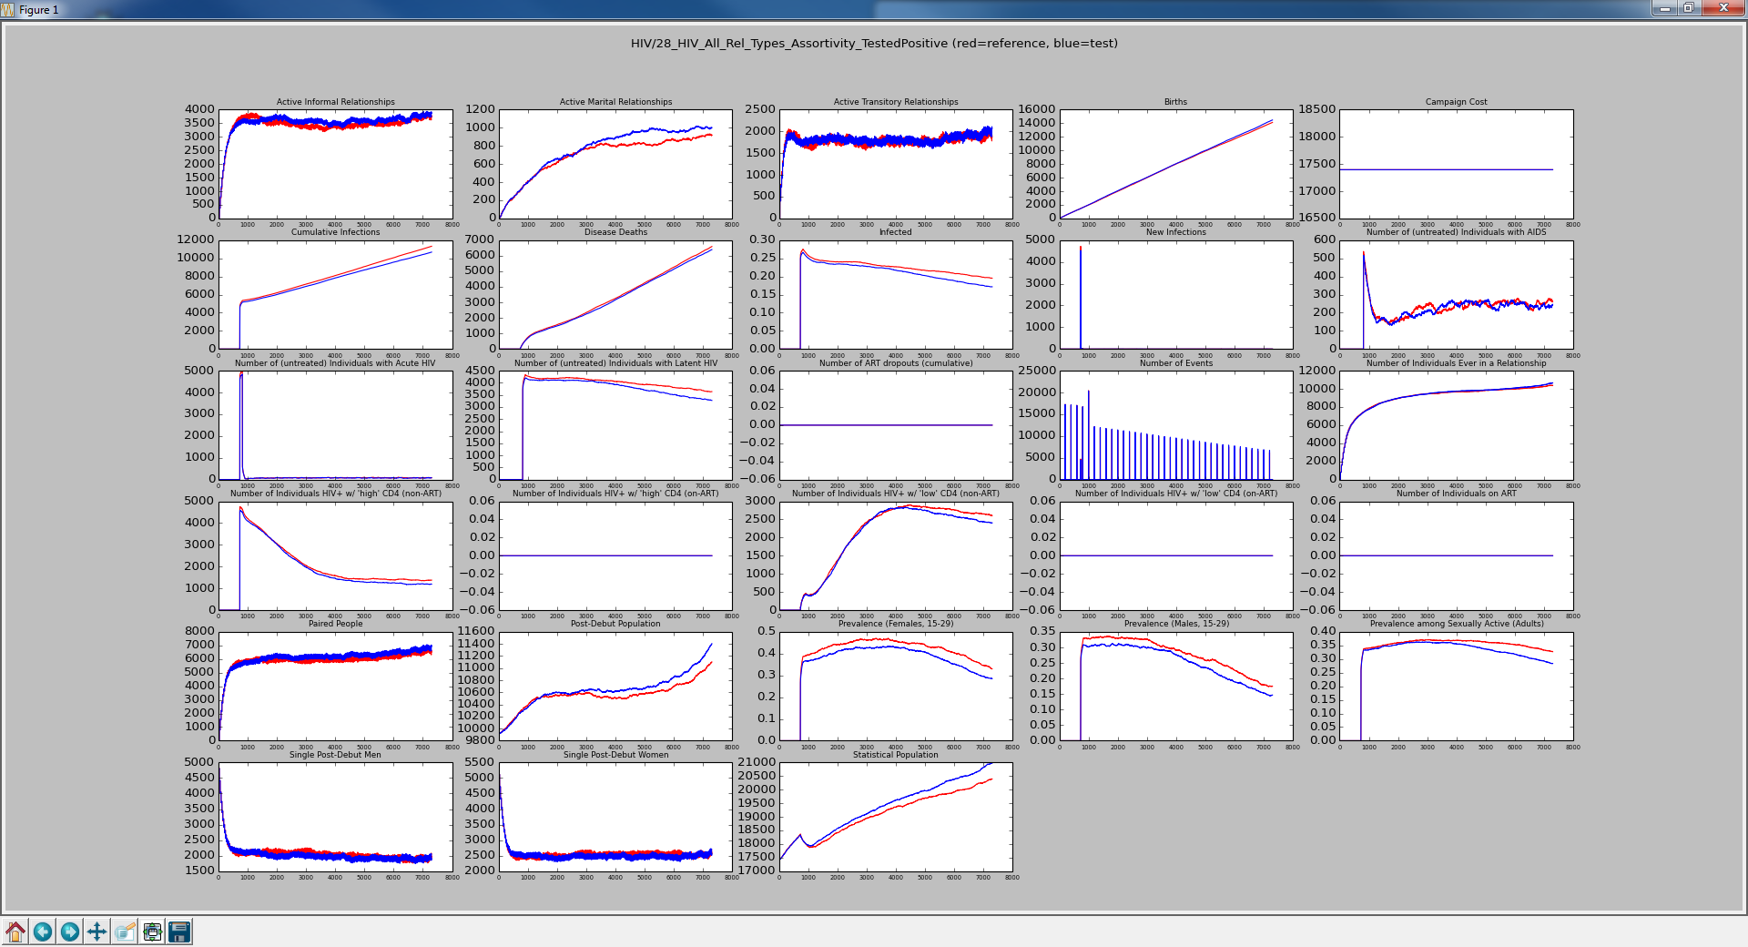
Red is All Types with No Groups Blue is All Types with Matrix
[0.6, 0.4],
[0.4, 0.6]
More spread of disease

Slide 10
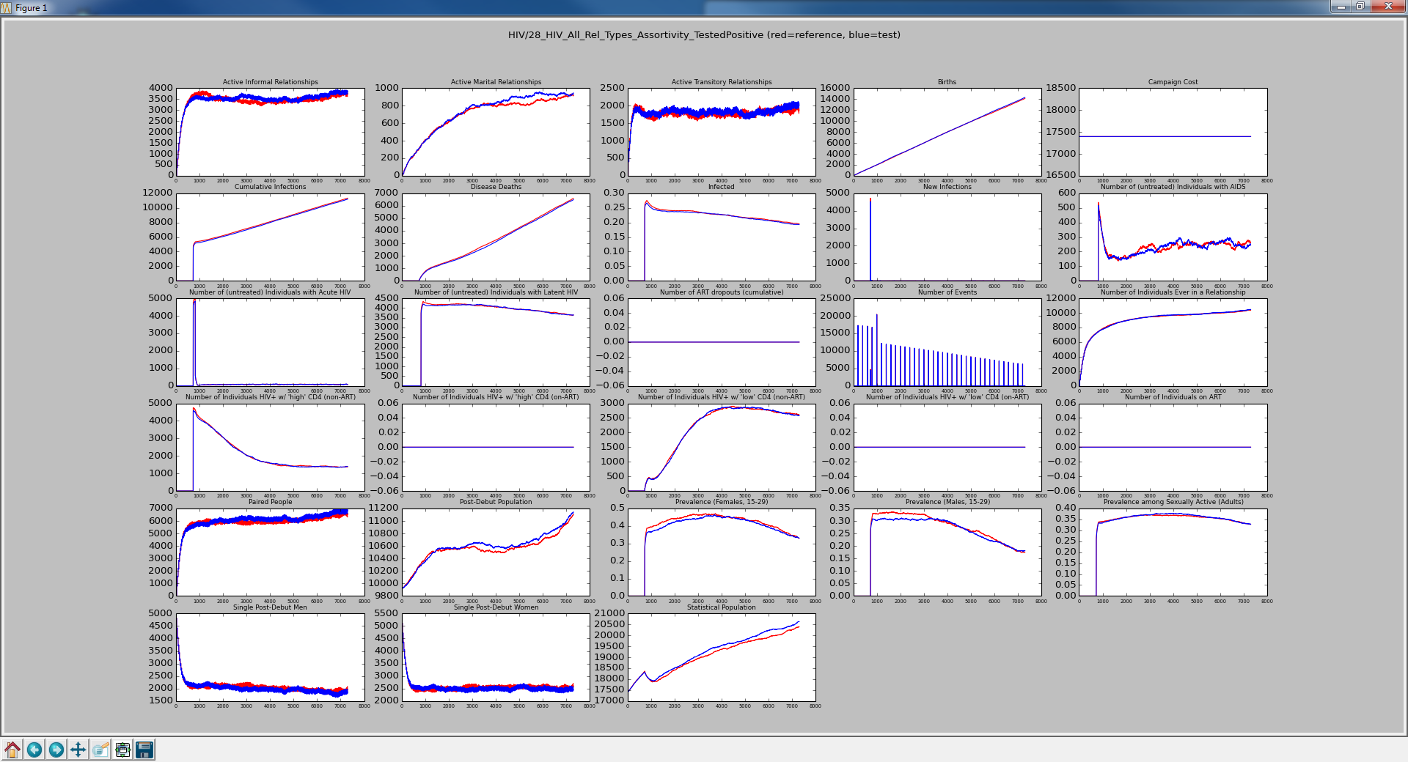
Red is All Types with No Groups Blue is All Types with Matrix
[0.5, 0.5],
[0.5, 0.5]
Similar to NO_GROUPS

Slide 11

Red is All Types with No Groups Blue is All Types with Matrix
[0.25, 0.75],
[0.75, 0.25]
Forcing more mixed relationships causes more spread of disease

Slide 12
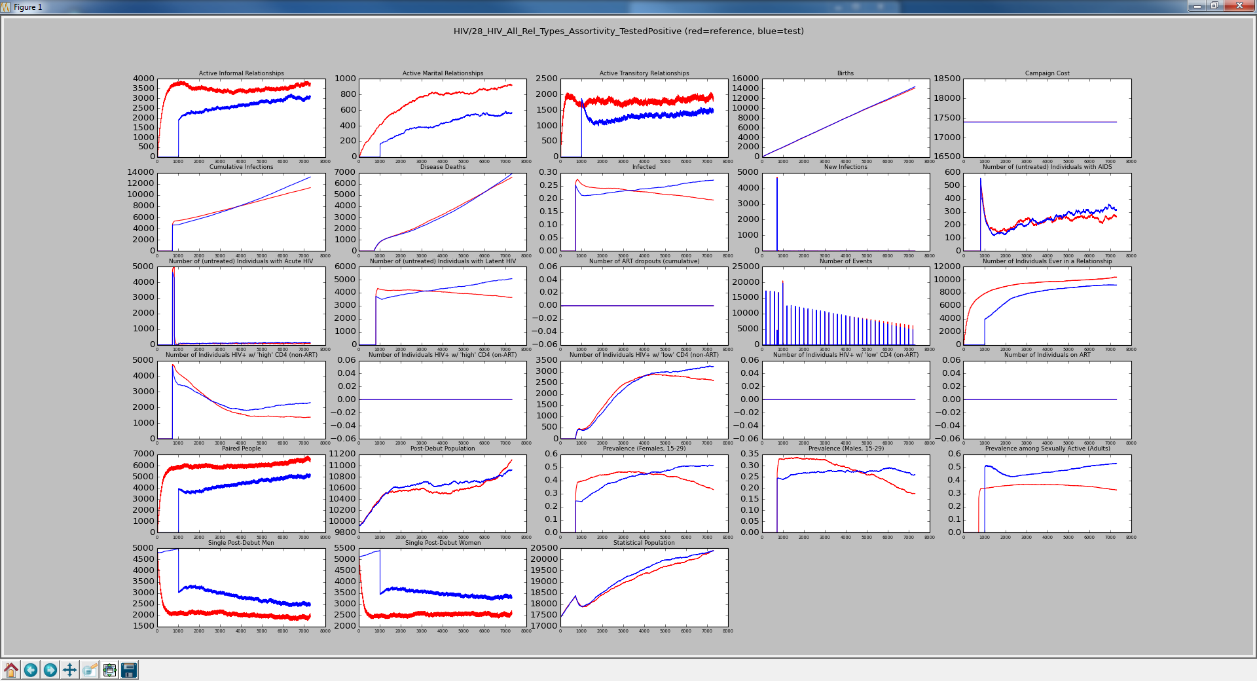
Red is All Types with No Groups Blue is All Types with Matrix
When not allowing mixed relationships, we see that relationships are not formed until the first test after the outbreak.
[0.0, 1.0],
[1.0, 0.0]

Slide 13
Test Update
Changed simulation duration from 7300 to 3000 to reduce runtime from > 5 minutes to less than 2.5 minutes

Slide 14
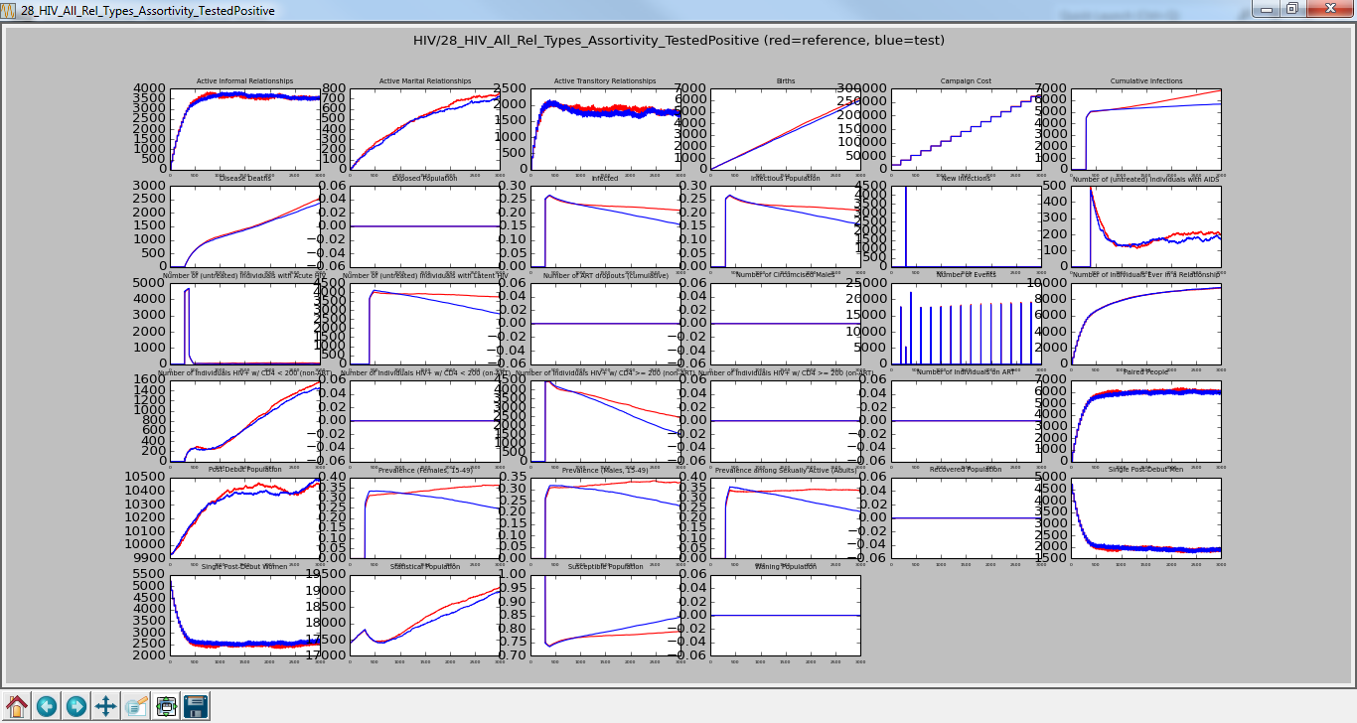
Red is All Types with No Groups Blue is All Types with Matrix
[1.0, 0.0],
[0.0, 1.0]
Simulation_Duration : 3000
Reduces runtime from > 5 minutes to less than 2.5 minutes

Slide 15
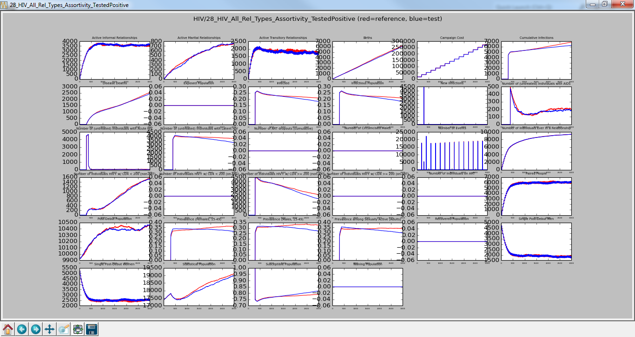
Red is All Types with No Groups Blue is All Types with Matrix
[0.9, 0.1],
[0.1, 0.9]
Simulation_Duration : 3000
Checked-In

